Slide 1
Primo VE Configurations
Lauren McFall Web Services + Emerging Technologies Librarian MiraCosta College

Slide 2
How much experience do you have with Primo VE?
I’m an expert
I’m comfortable, but still have questions
I’m a beginner but need to make customization changes.
I’m a beginner and not responsible for customization changes.

Slide 3
Are you alone?
No
Neither are the work groups
CSUs, Orbis-Cascade, SUNY

Slide 4
What are the advantages of a unified Library System Platform?
Share materials
Share strategies
Provide common framework
Teamwork!

Slide 5
Discovery and User Experience Work Group
Aloha Sargent
Amy Brinkley
Deborah Stephens
Erin Daniels
Ian Chen (CSU San Marcos)
Jin An-Dunning
Ken Lin
Robin Babou
Sally Ellis
Will Breitbach
Yvonne Reed

Slide 6
What will we cover today?
What is Primo VE?
What is recommended for customization?
How can you customize Primo VE?

Slide 7
What is Primo VE?
Lives within Alma
Controls discovery
Controls look and feel

Slide 8
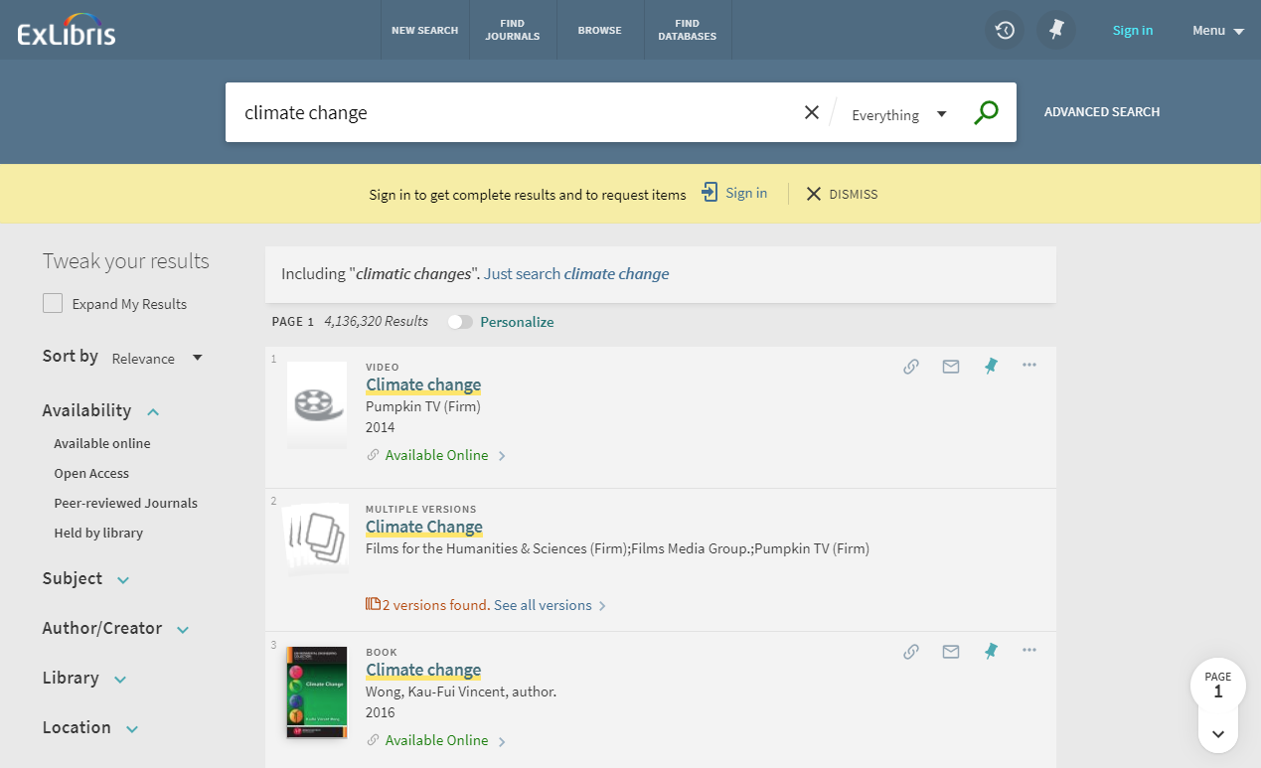
What can we customize in Primo VE?

Slide 9
What should we customize in Primo VE?
First Day Ready
Revise Later

Slide 10
Primo VE Configuration Recommendations
https://tinyurl.com/cclprimo

Slide 11
How can you customize Primo VE?
Using Discovery within Alma
Configure Views
Labels
Through CSS and JS

Slide 12
What is next for the Discovery Group?
CSS template document
Search box code for homepages
Webinars

Slide 13
Lauren McFall
!
?
☺😐☺
lmcfall@miracosta.edu

