Slide 1
ENGAGING STUDENTS IN AN ONLINE LIBRARY
FEATURING ELIZABETH HORAN (LIBRARIAN, COASTLINE COLLEGE)
MAY 1, 2020

Slide 2
Welcome
Evelyn Lord, Moderator
Secretary, Council of Chief Librarians
Head Librarian, Laney College
Romelia Salinas, Chat Monitor
Los Angeles Regional Representative, Council of Chief Librarians
Associate Dean, Library & Learning Resources Division, Mt. San Antonio College

Slide 3
Meeting Logistics
This session is being recorded
Use Chat to ask questions

Slide 4
CCL Reminder
Call to Participate 2020-21
Library Services Platform (LSP) Workgroups
Apply to serve on a workgroup:
https://docs.google.com/forms/d/e/1FAIpQLSeoS8qzROe0dqhYa29lQ_lrlYANIY6-0YDl2MnEFH5xQJydeg/viewform
Deadline: May 29, 2020

Slide 5
Featured Speaker
Elizabeth Horan
Librarian, Coastline College

Slide 6
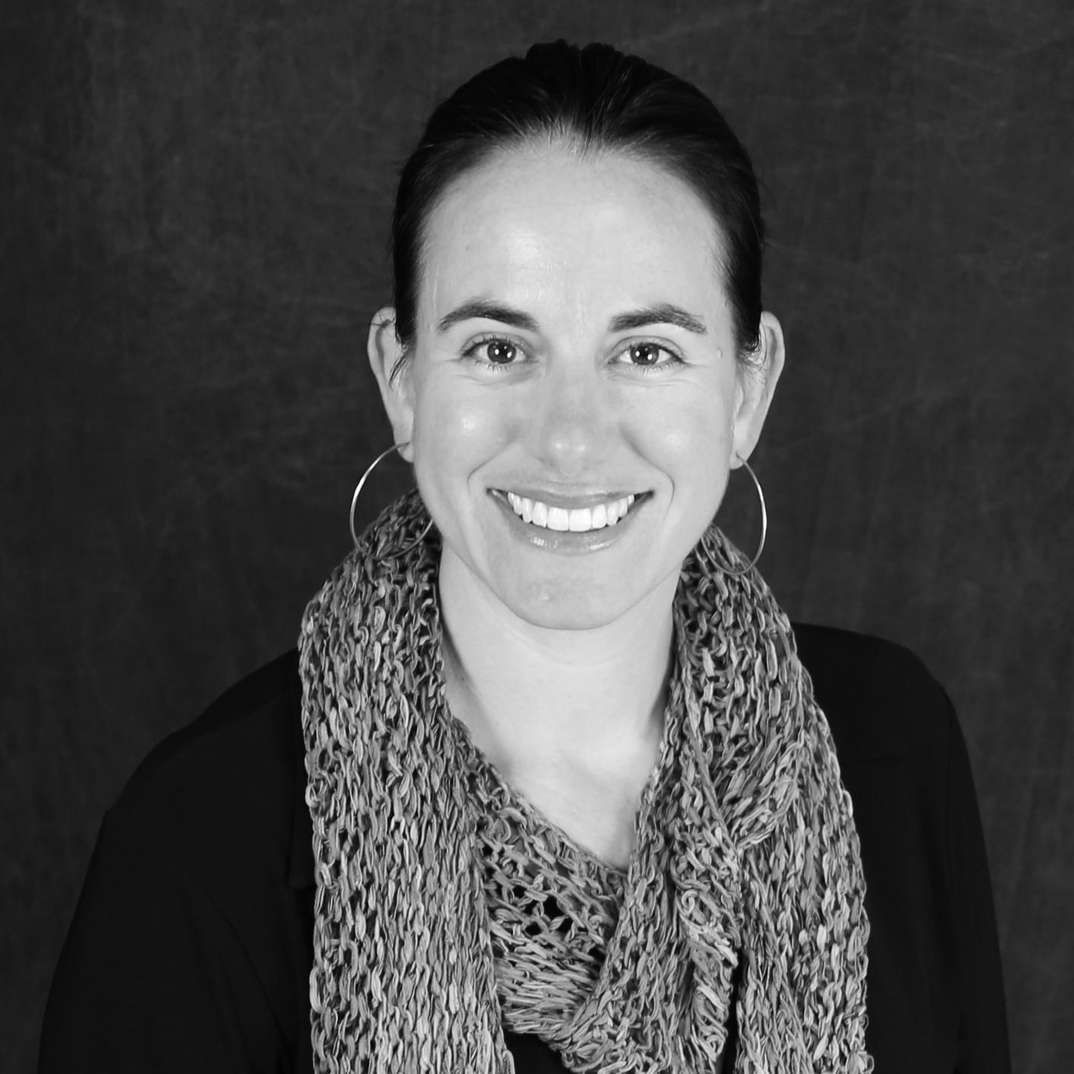
Engaging Students in
an Online Library
What does “engage” mean
Engaging Library Websites
Engaging Online Library Instruction
Showing engagement to Library Stakeholder
What is the long term plan?
Elizabeth Horan
Coastline Community College
ehoran@coastline.edu
1

Slide 7
?
Who are you?
Zoom Poll
2

Slide 8
Food for thought…..
Sustainability
Workforce
3

Slide 9
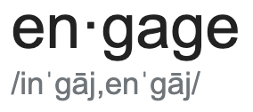
What does “engage” mean?
occupy, attract, or involve (someone's interest or attention).
participate or become involved in.
Source - Google search - engage
4

Slide 10
What does “engage” mean in a Physical Library?
Library
5

Slide 11
What does “engage” mean in an ONLINE Library?
Online Library
Source https://www.hiclipart.com/
6

Slide 12
Engaging Library Websites and Content
Why do students go to your library webpage
A.K.A. your Online Library
7

Slide 13
Engaging Online Library Instruction
Online Library instruction - what I do and why
What are the options?
How will this be sustained?
8

Slide 14
Library Stakeholders
Library Staff
Alumni
Students Clubs
Tutoring
Groups with $$$
Librarians
Students
New Students
Academic Senate
LIBRARY
Faculty
Part time faculty
State Academic Senate
New faculty
Community
Administrators
Public Library
College Grant Office
Board of Trustees
Friends of the Library
Foundation
Bookstore
College staff
9

Slide 15
What is the long term plan?
What does “engage” mean
Engaging Library Websites
Engaging Online Library Instruction
Showing engagement to Library Stakeholder
What is the long term plan?
Now what?
10

Slide 16
?
Thank you!
Zoom Poll
11

Slide 17
Next Week
Friday, May 8 (10:30 am – 12:00 noon)
Accessibility and CCC Libraries
Sean Keegan (Director, CCC Accessibility Center)
With Special Guest Moderator: James Wiser
Look for registration link in email on Monday

Slide 18
Thank you.
Council of Chief Librarians
https://cclibrarians.org/

