Slide 1
WELCOME
CCL FALL 2020 WORKSHOP
ANTI-RACISM &
LIBRARIES
A C O N V E R S A T I O N W I T H
A L A P R E S I D E N T
J U L I U S C . J E F F E R S O N, J R .
December 10, 2020
Moderator: Romelia Salinas, rsalinas12@mtsac.edu

Slide 2
Anti-Racism & Libraries: A Conversation with ALA President Julius C. Jefferson, jr.
MEETING LOGISTICS
Q&A following the presentation
Submit questions via the Q&A option
Chat will be used by panelist to share information only
Please submit evaluation form which will be emailed out following the event
Photo by Mariia Zakatiura on Unsplash

Slide 3
New Strategic Goal
Goal D: Collaborate with libraries, districts and other entities in the work needed to support social justice, dismantle structural racism, and promote anti-racism in California’s Community Colleges
Strategy D1 – Support the development of strategies, policy and procedure at the local and statewide level to improve access and success for historically marginalized populations
Strategy D2 – Promote the acquisition of collections and resources that support inclusive and anti-racist programs and curriculum, reflective of the community at large
Strategy D3 – Support libraries in providing inclusive and welcoming learning environments that are safe and accessible, ensuring equitable access to library materials and services
Strategy D4 – Encourage the recruitment, hiring and retention of librarians and library staff from diverse backgrounds

Slide 4
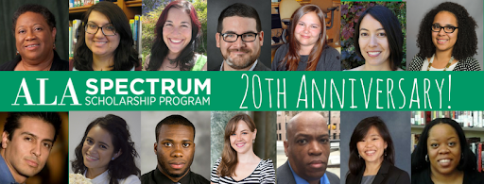
ALA Spectrum Scholarship Program
The Spectrum Scholarship Program actively recruits and provides scholarships to American Indian/Alaska Native, Asian, Black/African American, Hispanic/Latino, Middle Eastern and North African, and/or Native Hawaiian/Other Pacific Islander students to assist them with obtaining a graduate degree and leadership positions within the profession and ALA.

Slide 5
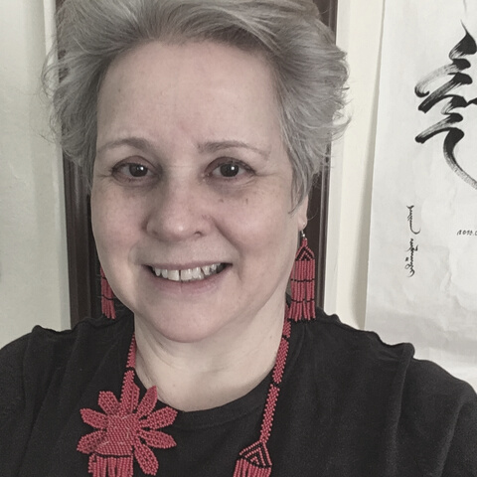
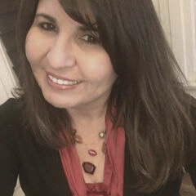
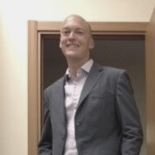
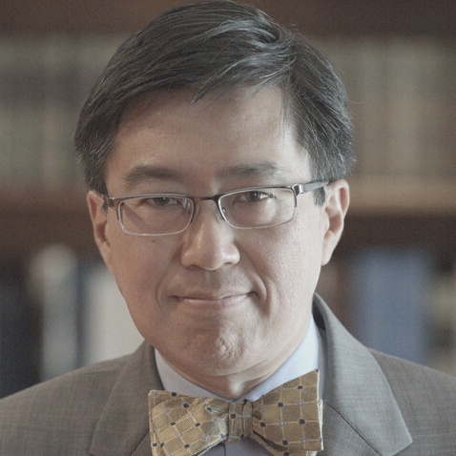
CCL Professional Development
& Leadership Team
Evelyn Lord
Tina Inzerilla
Romelia Salinas
Peralta Community College
La Positas College
Mt. San Antonio College
Eric Hanson
Brian Lym
Glendale Community College
Napa Valley College

