Slide 1
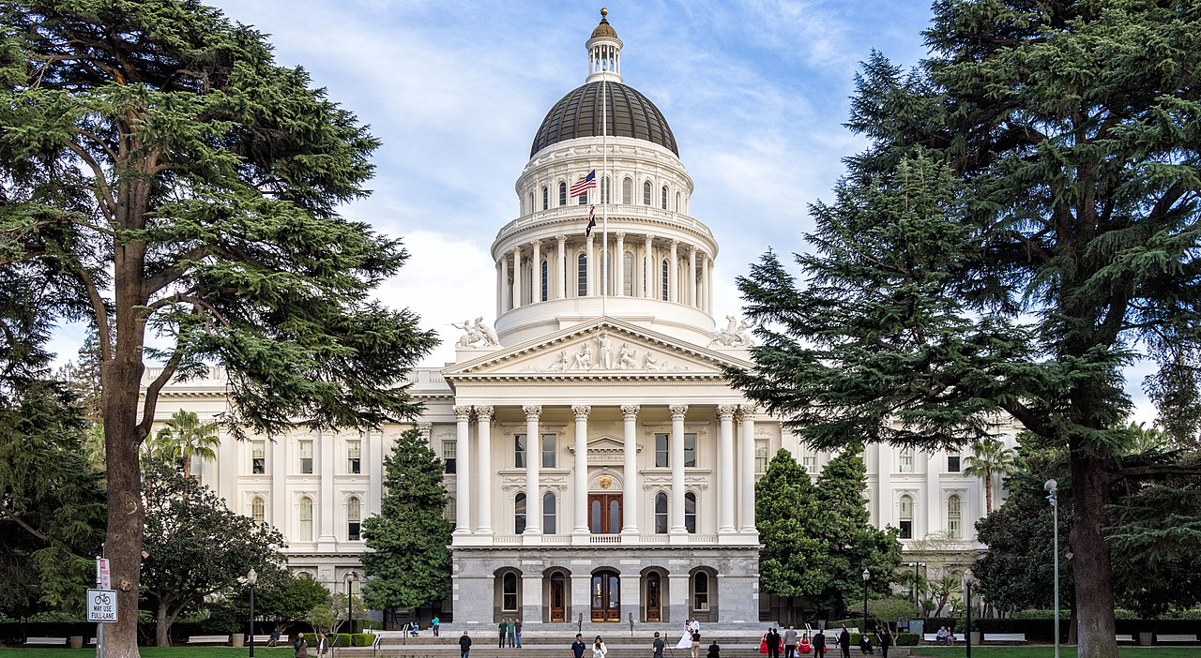
Library Consortium Director’s Report CCL Deans & Directors Meeting March 21, 2019
James Wiser
CCL
Dean’s & Director’s Meeting
March 8, 2018
Sacramento, CA

Slide 2
Outline
Aggregate Licensing
State of Price Increases
Trends
Things To Know This Year
Questions, Comments, and Feedback

Slide 3
Aggregate Licensing* FY2014: $6,015,187 FY2015: $6,181,137 FY2016: $7,938,612 FY2017: $10,053,739 FY2018: $10,693,832
*Does not include the Statewide EBSCO purchase

Slide 4
Participation Report
Top Vendors:

Slide 5
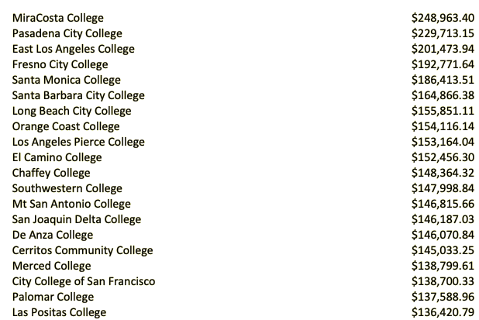
Participation Report
Top Spenders in FY2018:

Slide 6
Trends: State of Price Increases
The Good: 0% increases from several (JSTOR, Ambrose Video, Intelecom, Mosio)
The OK: Noodletools (3%) EBSCO (4%), Oxford University Press* (5%), Lexis-Nexis (5%), SAGE (5%), Proquest (5%), Gale (5%), World Book* (3%), Newsbank (5%)
The Ugly: McGraw-Hill (6%), Springer Nature (7%), Swank (9%+), Science (+20%)
FY 2018 vs FY 2017: Avg. increase of 4.03%

Slide 7
Things To Know This Year
Library Consortium Business Model Review
Pay Your Bills
New Procurement System Is Coming
We Don’t Work With Some Vendors (Ahem, Kanopy)
PAY YOUR BILLS

Slide 8
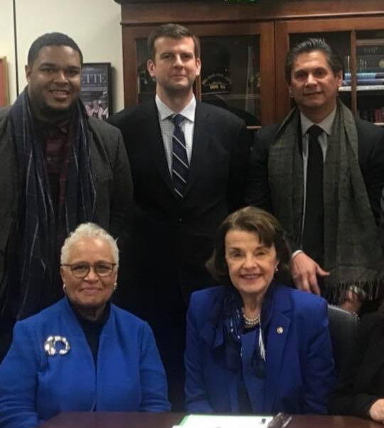
…or my friends will find you.

Slide 9
Questions/Comments/Concerns? James Wiser jwiser@ccleague.org 916.800.2175

